Slide 1
Probabilistic data structures in Go
Notes:
https://www.youtube.com/watch?v=-tT40zeWgXM copy from https://github.com/jayapriya90/gonorthwest2018

Slide 2
Agenda
Introduction to Probabilistic Data Structures
User Case
Bloom Filter
Count-Min Sketch
HyperLogLog
Example walkthrough
Takeaways

Slide 3
Introduction
Probabilistic(Skeching) data structure stores a summary of the dataset as opposed to store the data entirely (prohibitively expensive in terms of memory usage)
Probabilistic data structure are approximate – trade accuracy for space

Slide 4
Use cases
Membership check – To check whether an element exists or not before performing an expensive operation(typically IO intensive)
Frequency check – To find the frequency of element in an infinite stream
Distinct count – To count how many unique elements are present in a stream

Slide 5
Use cases
Cache Optimization (can prevent “one hit wonders”)
URL shorteners
Web Browsers
To reduce the DB lookups(Disk IO) in Postgress,BigTable,Apache Hbase,Apache Cassandra
Type Ahead Search
Filtering Feedss

Slide 6
Blooming Filter
A highly space-efficient probabilistic data structure that is used to check whether an element is a member of a set
False positive matches are possible, but false negatives are not
False positive:element does not exist but bloom filter says it does
False pegative:element does exist but bloom filter says it does not
BloomFilter.test(element) -> “possibly in set” or “definitely not in set”

Slide 7
What can bloom filter answer?
Questions likes:
Is this URL malicious?
Is this IP address blacklisted?
Does this zone ID exist in the database?

Slide 8
How it work?
Support 2 operations:add, lookup
Allocate bit array of length m
K hash function
Configure m and k for desired false-positive rate

Slide 9
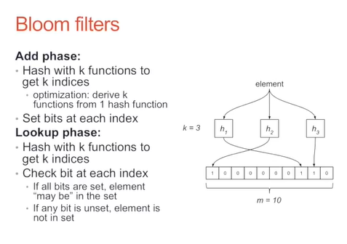

Slide 10
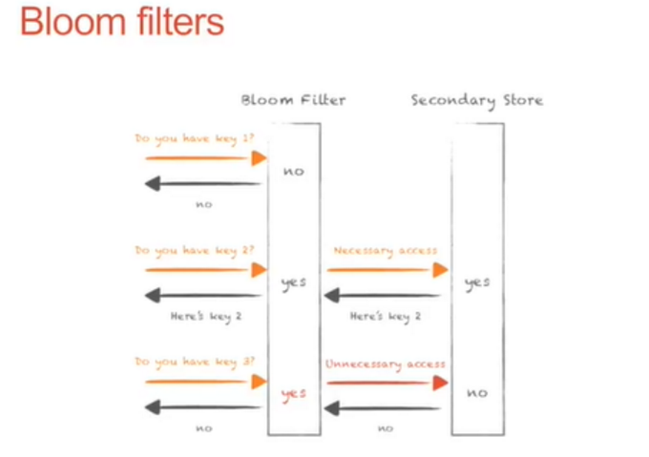

Slide 11
Bloom filters
Benefits
More efficient than hash table or bit array
Can determine trade-off between accuracy and space
Drawbacks
Does not support deletes
Requires a priori knowledge of the dataset for initializing bloom filter
Over-provisioned filter wastes space, under-provisioned filter increases error rate

Slide 12
Bloom filters variations
Rotating bloom filters – remember everything in the last hour
Stable bloom filters – continuously evict stale data
Cuckoo filter

Slide 13
DEMO

Slide 14
Count-Min Sketch
Count-Min Sketch is a probabilistic data structure that serves as a frequency table if events in a stream of data
Use hash functions to map events to frequencies , but unlike a hashtable use only sub-linear space, at the expense of over-counting some events due to collisions
Similar to bloom filter but instead of setting a bit increment a count

Slide 15
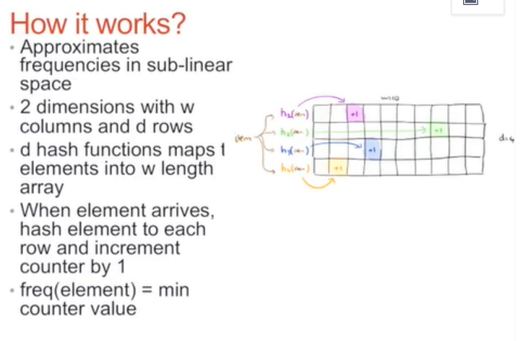

Slide 16
Why minimum?
Why do we take minimum counter value as the frequency of the element?
Possibility of collision between elements
Counter may be incremented by multiple elements
Greater the width(w) and height(d) more space,less collision,high accuracy

Slide 17
Count Min Sketch
Benefits
Sub-linear space
Useful for detecting “heavy hitter”
Easy to track top-k by add a min/max heap
Drawbacks
Biased estimator:may overestimate,never undererestimates

Slide 18
DEMO

Slide 19
HyperLogLog
Many used for approximately counting distinct elements
Counter per element explodes memory
Usually requires memory proportional to cardinality
Example
How many unique words are used in Wikipedia?
What is the cardinality of a column in database?

Slide 20
How it works?
Hash element to an integer
Count number of leading 0’s in binary form of hash
Track highest number of leading 0’s as n
Cardinality ~= 2 ^(n+1)

Slide 21
HyperLogLog
List=[“foo”,“bar”,”baz”,”qux”]
H(“foo”)=10100001
H(“bar”)=01110111
H(“baz”)=01110100
H(“qux”)=10100011
n=1
|stream|~=2(n+1)=4

Slide 22
DEMO

Slide 23
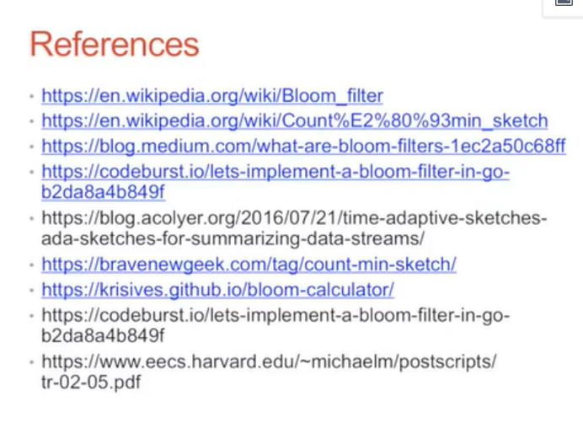

Slide 24
Thank you!
https://twitter.com/xiaozhiliaoo
xiaozhiliaoo@gmail
https://github.com/xiaozhiliaoo

